Slide 1
Frontend-Backend Communication with PHP
Dr Govindha Ramaiah Yeluripati

Slide 2
Outline
Input in PHP
Working with Forms
JavaScript 'fetch' API
RESTful APIs in PHP
Error Handling and Debugging
Sessions and Cookies
Security Essentials

Slide 3
Input in PHP
Input is the basis for client-server communication
Most common methods to handle input in PHP:
Form input
  Sanitize input to protect against security risks
File Uploads
Cookies and sessions
Command-Line Argument (CLI)
Other forms of user interactions/requests (Actions, Events) that may not involve data transfer also may trigger client-server communication.

Slide 4
Using Superglobals for Input Handling
Superglobals are predefined arrays that are globally accessible across all scopes.
Used to handle
  input data,
  session information,
  server details, and
  environment settings.

Slide 5
Superglobal Variables
$_GET
Used to collect data sent to the server via the HTTP GET method.
Often used to retrieve query parameters from the URL.
Example:
$_GET['id'] retrieves the id parameter from the URL: example.com/page.php?id=5
$_GET['name'] retrieves the name parameter from the URL: example.com/page.php?name=John

Slide 6
Superglobal Variables
$_POST
Used to collect form data sent to the server via the HTTP POST method.
Preferred for handling sensitive data, as data sent with POST does not appear in the URL.
Example:
$_POST['username'] retrieves data from an HTML form field with name="username"

Slide 7
Superglobal Variables
$_REQUEST
Contains all data from GET, POST, and COOKIE requests.
Although versatile, $_REQUEST is typically avoided when specific data sources (GET or POST) are expected for clarity and security.
Example:
$_REQUEST['email'] would retrieve email from either GET, POST, or COOKIE data.
NB: using unique values for the name attribute in form fields is crucial for clarity and to avoid data conflicts

Slide 8
Superglobal Variables
$_SESSION
Used to store user session data across multiple pages.
Session data persists as long as the user’s session is active, which is useful for tracking logged-in users.
Example:
$_SESSION['user_id'] = 123; //stores a user ID in the session
$_SESSION['theme'] = 'dark'; //stores the theme preference
$_SESSION['cart'] = ['item1' => 2, 'item2' => 1]; // stores items and their quantities in the shopping cart

Slide 9
Superglobal Variables
$_COOKIE
Used to retrieve data stored in cookies, which are small pieces of data saved on the user’s device.
Cookies persist even after the session ends, so they are commonly used for preferences, tracking, etc.
Example:
$_COOKIE['theme'] retrieves the value of a cookie named theme.

Slide 10
Superglobal Variables
$_FILES
Used for handling file uploads in PHP.
Contains information about files uploaded via a form, including file name, size, type, and temporary file path.
Example:
$_FILES['file']['name'] retrieves the original name of an uploaded file with name="file" in the form.

Slide 11
Superglobal Variables
$_ENV
Contains environment variables, typically set outside PHP, like in a web server or operating system configuration.
Useful for configuration details that should not be hardcoded (e.g., database credentials).
Example:
$_ENV['DB_HOST'] could retrieve the database host if it’s defined as an environment variable.

Slide 12
Superglobal Variables
$_SERVER
Provides information about the server environment and the client’s request.
Useful data includes
  request method ($_SERVER['REQUEST_METHOD']),
  client IP address ($_SERVER['REMOTE_ADDR']), and
  server software
Example:
$_SERVER['HTTP_USER_AGENT'] retrieves information about the client’s browser.

Slide 13
Superglobal Variables
$GLOBALS
Contains references to all global variables in the current script.
Contains references to superglobals too.
Allows access to any variable from anywhere in the script by its name.
Example:
$GLOBALS['varName'] would allow access to a variable named $varName from any scope.

Slide 14
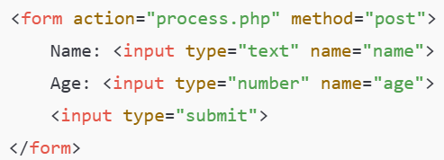
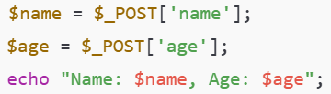
Form Input
One of the most common sources of data
The method attribute in the HTML <form> element is used to specify the request type/method like POST or GET.
Example (HTML form) – Client-side code:
Example (php) – Server-side code:

Slide 15
Form Input: Sanitizing Input
IMPORTANT: Use functions like htmlspecialchars() and filter_var() to sanitize and validate input.
This will prevent cross-site scripting (XSS) and SQL injection attacks.
Example (php) – INSECURE Server-side code: (Not recommended)
Example (php) – SECURE Server-side code: (Recommended)

Slide 16
Practice Exercise 1: Simple Form-based Client-Server Communication
Simple Form Submission with PHP:
Create a simple HTML form with two fields: name (text) and age (number). The form should submit data to a PHP script using the POST method.
In the PHP script, retrieve the submitted name and age values using $_POST.
Display a greeting message using these values (e.g., "Hello, [name]! You are [age] years old."). Add basic validation in PHP to check if the fields are empty and display an error message if they are.
Expected Output: The PHP script should respond with a personalized message or an error if the form is submitted empty.

Slide 17
Practice Exercise2: Simple Form-based Client-Server Communication
Simple Form Submission with PHP:
Practice handling basic form input (email and color) using PHP’s $_POST superglobal.
Create an HTML form that collects an email address (email), a favorite color (color). Submit the form data to a PHP script using the POST method. In the php script, retrieve and display the email and color in a greeting message.
e.g., "Your email is [email], and your favorite color is [color]").

Slide 18
Form Input: Performing CRUD operations in Database
We can perform CRUD (Create, Read, Update, Delete) operations using form-based input in PHP.
Create (Insert Data):
Use an HTML form to gather input data from the user (e.g., name, age, etc.).
On form submission, use the POST method to send data to a PHP script.
In the PHP script, use an INSERT SQL statement to add the data to the database.

Slide 19
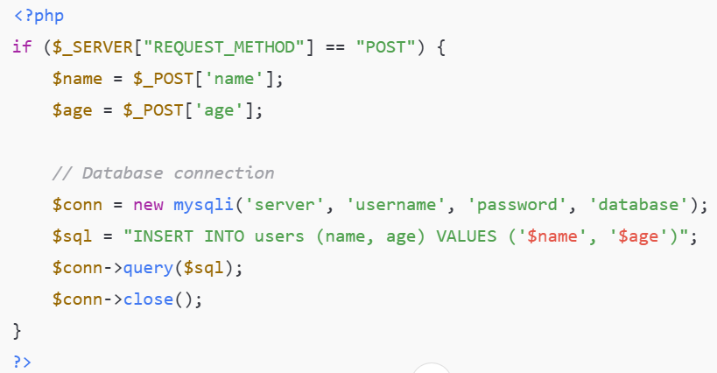
Form Input: Performing CRUD operations in Database
Create (Insert Data) Example
Do not forget to sanitize and validate

Slide 20
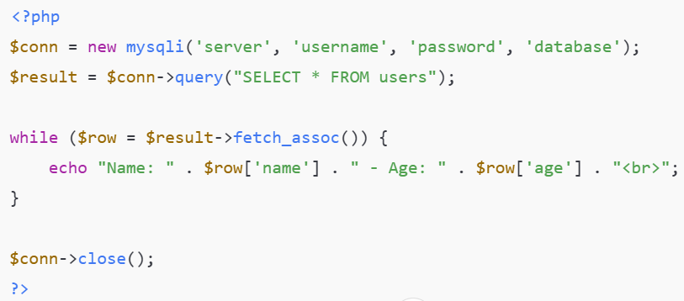
Form Input: Performing CRUD operations in Database
Read (Display Data) with Example
Fetch data from the database using a SELECT SQL query
Display the data on a webpage by embedding PHP within HTML

Slide 21
Form Input: Performing CRUD operations in Database
Update (Edit Data):
Use a form to allow the user to input new data to update
Send the updated data along with the ID of the record to a PHP script, typically using POST
In the PHP script, use an UPDATE SQL statement to change the data.

Slide 22
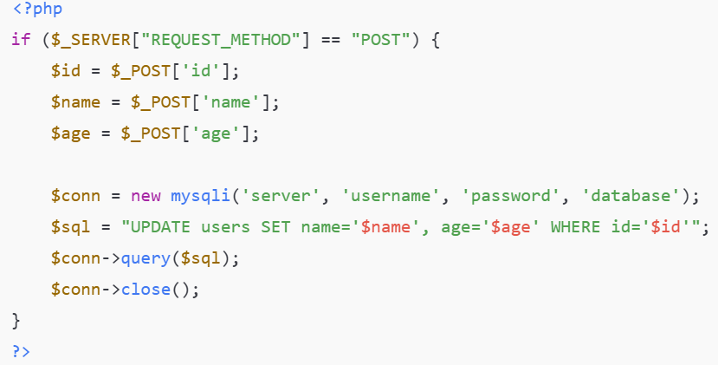
Form Input: Performing CRUD operations in Database
Update (Edit Data) Example

Slide 23
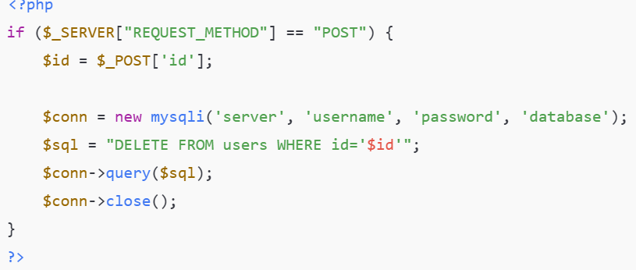
Form Input: Performing CRUD operations in Database
Delete (Remove Data) with Example
Use a form or a button to select the record to delete.
Send the ID of the record to a PHP script using POST.
Use a DELETE SQL statement in the PHP to remove the record.

Slide 24
Exercise: Performing Database CRUD Operations with Form Input
Design a PHP-based CRUD application to manage a simple database table, users, which contains fields id (auto-increment primary key), name, and age.
Idea:
Create a MySQL database with a users table, as defined.
Build an HTML form interface in PHP to perform the following:
  Create: Insert a new user with name and age.
  Read: Display a list of all users in a table format.
  Update: Modify a user’s name and age based on their ID.
  Delete: Remove a user based on their ID.
Test each form-based action (Create, Read, Update, Delete) to ensure it interacts with the database correctly.

Slide 25
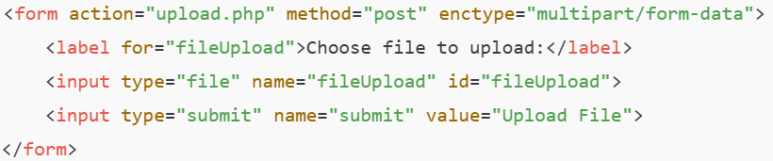
Form Input: File Uploads
Step 1: Create an HTML form with the attribute enctype = "multipart/form-data" to allow file uploads.
The "file" input type enables users to select a file.
Example:
Step 2: In the server-side PHP script 'upload.php', write the code to handle the file upload. (Example uploaded to Canvas)
PHP stores uploaded files in a temporary directory before it is decided choose a specific directory to store them permanently.

Slide 26
RESTful API Design
REST (Representational State Transfer) is an architectural style for designing Web applications.
A RESTful API in PHP is structured around:
Resources: Represented by URLs.
HTTP Methods: Commonly GET, POST, PUT / PATCH and DELETE.
Status Codes: For success (200s), errors (400s, 500s), etc.
Data Formats: Often JSON (JavaScript Object Notation) for data interchange.

Slide 27
RESTful API Design
STEP1: Create a directory structure for the project
Example: 
my-restful-api/
index.html
api/
config/
objects/
user/
database.php
user.php
create.php
read.php
update.php
delete.php

Slide 28
RESTful API Design
STEP1: Create a directory structure for the project
Example: Explanation
The root project folder is my-restful-api/
The root folder contains an api/ folder for the backend code and an index.html file for the frontend code.
The api/ folder contains
  a config/ folder for configuration files, for example, database.php,
  an objects/ folder for object (or resource) definitions, for example, user.php,
  a user/ folder that includes files for CRUD operations on the 'user' resource, for example, create.php, read.php, update.php, and delete.php

Slide 29
RESTful API Design
STEP1: Create a directory structure for the project
Example: Explanation
End Point: Each CRUD file (e.g., create.php, read.php) defines an endpoint for the API.
Files like database.php and user.php support the endpoints by handling database connections and defining the 'resource model'.
In general, endpoints allow specific, organized access to different functionalities in an API. They go beyond CRUD and include Authentication (e.g., login, register), Account management (e.g., update profile), Search and filter etc.

Slide 30
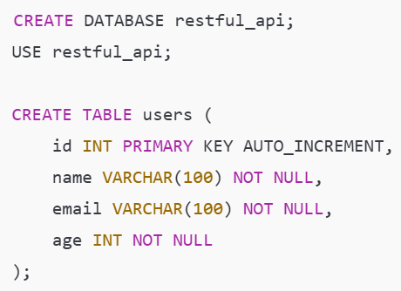
RESTful API Design
STEP 2: Setup Database
Create a MySQL database with a table for the resource users. You can use phpmyadmin visual elements or the following commands for our example project.

Slide 31
RESTful API Design
(Check the Sample code uploaded to Canvas)
STEP 3: In the database.php file, define the database connection
STEP 4: Define the user object (resource): In user.php file, define the User class and CRUD methods.
STEP 5: Create the API Endpoints:
  Create a New User – In create.php, add code to handle the POST request.
  Read All Users – In read.php, return all users in JSON format.
  Update User – In update.php, handle updating a user’s details based on the provided id
  Delete User – In delete.php, delete a user from the users table based on their id
STEP 6: Implement the Frontend: In index.html, set up a frontend to communicate with the API endpoints created in STEP 5.

Slide 32
RESTful API Design
Access the App via the following URL (if the Web App is hosted on the local machine):
http://localhost/my-restful-api/index.html
Note: The Apache server and the phpMyAdmin should be running on the XAMPP.

Slide 33
Thank you
Questions???
Dr Govindha

